Slide 1
Assessment & Evaluation in Physical Education
Brigitte Webster
Grade 5/6
WCDSB

Slide 2
Assessment for, as and of Learning…
Assessment for learning...
  What skills are your students coming in with?
  This is your diagnostic assessment.
  Marks are not used when deciding on final report card grades.
Assessment as learning...
  What skills are your students developing and what still needs attention?
  This is your formative assessment.
    How are you tracking their progress?
    Checklists; Anecdotal Observations; Conferencing; Testing
  Marks are not used when deciding on final report card grades.
Assessment of learning...
  What skills have your students gained?
  This is your summative assessment.
  Marks are used when deciding on final report card grades.
    You must be able to justify to a parent or administrator how/why you assigned your grade.
    Think… exemplars;, leveled work comparison; moderated marking, rubrics, success criteria.
Notes:
----- Meeting Notes (11-09-14 21:13) -----
You're going to hear a lot of education lingo here!!
These are the current buzz words in education and it would be my recommendation that you are familar with buzz words as educators generally are impressed when you sound like you know what you are talking about!

Slide 3
Examples of Previous Mark Books
MARK BOOK – OLD SCHOOL 1
Student | BBall | VBall | FHockey | Attitude | Part. | Effort |  | Grade
A | 9/10 | 8/10 | 8/10 | 7/10 | 10/10 | 8/10 | 50/60 | 83%
B | 6/10 | 4/10 | 6/10 | 3/10 | 5/10 | 5/10 | 29/60 | 48%
C | 7/10 | 7/10 | 7/10 | 10/10 | 10/10 | 10/10 | 51/60 | 85%
MARK BOOK – OLD SCHOOL 2
Student | BBall | VBall | FHockey | Attitude | Part. | Effort |  | Grade
A | A | A- | A- | B- | A+ | A- | A- | 4-
B | C- | R | C- | R | D- | D- | F | R
C | B- | B- | B- | A+ | A+ | A+ | A- | 4-

Slide 4
WHAT SHOULD YOUR MARK BOOK LOOK LIKE TODAY?
Learning Goal: B1.4 – Send & receive objects using different body
parts & equipment, adjusting for speed, while applying basic
principles of movement.³
Students | Knowledge & Understanding Understands techniques taught |  |  |  | Thinking Analyses movement skills |  |  |  | Communication Uses correct terminology |  |  |  | Application Applies skills in a variety of situations
 | VBall | BBall | FHockey |  | Vball | Bball | Fhockey |  | Vball | Bball | Fhockey |  | Vball | Bball | FHockey
A | 4 | 4 | 4- | 4 | 4 | 4 | 4 | 4 | 4 | 3+ | 4- | 4- | 3 | 3 | 3+ | 3 | 4-
B | 3 | 3- | 3- | 3- | 2 | 2 | 2 | 2 | 2 | 2+ | 3- | 2+ | 2 | 2 | 2- | 2 | 2+
C | 3 | 3 | 3 | 3 | 3 | 3 | 3 | 3 | 3 | 3 | 3 | 3 | 3 | 3 | 3 | 3 | 3
Notice we’ve lost attitude, participation & effort.
These are evaluated using a separate learning goal.

Slide 5
Evaluating Active Living
Not every specific expectation can be evaluated across the 4
achievement categories… and that is okay!!
A1.1 – Actively participate in a wide variety of program activities according to their
capabilities, while applying behaviours that enhance their readiness and ability
to take part.³
Students | Application Application of Knowledge & Skills
 | VBall | Bball | FHockey
A | 4 | 4 | 4 | 4
B | 3 | 3+ | 2 | 3
C | 2 | 2 | 3 | 2+

Slide 6
Assessing How Students Throw Objects
First… you must know what the developmental stages are when throwing object.
Second… you must communicate the Success Criteria to your students. Note that the Success Criteria must be grade level appropriate.

Slide 7
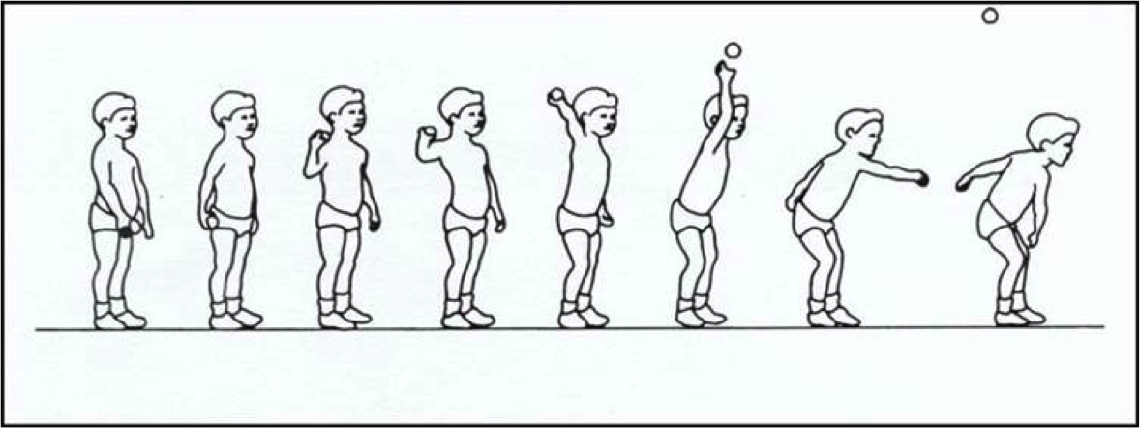
“Developmental Stages of Throwing”
Stage 1¹
Throwing motion is posterior-anterior in direction
Feet do not move
Little trunk rotation
Force for projecting the ball comes from hip flexion, shoulder protraction, and elbow extension

Slide 8
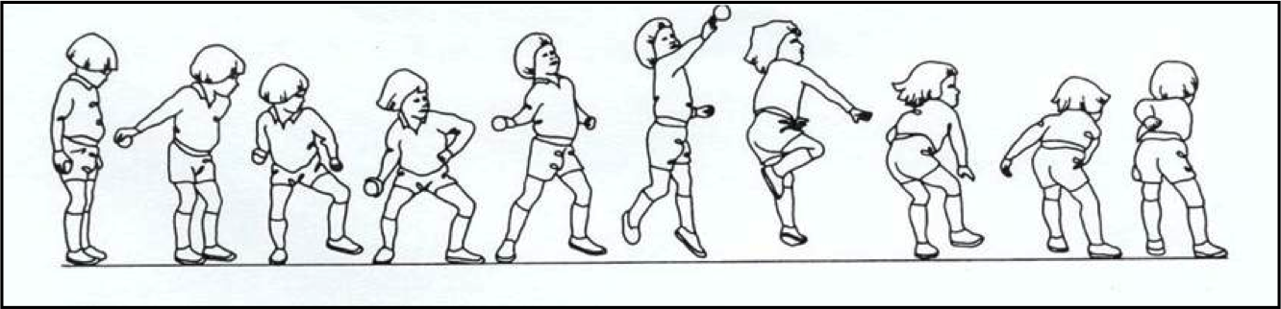
Stage 2¹
More rotation of the body
Performer may step forward (ipsilateral or contralateral pattern)
Arm brought forward in transverse plane
Form resembles a sling

Slide 9
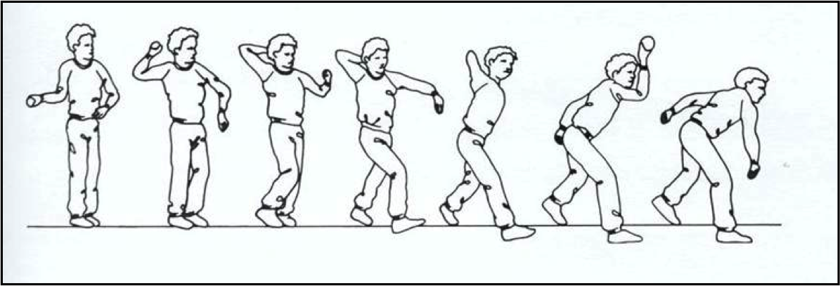
Stage 3¹
Note the ipsilateral arm-leg action
Ball is placed into throwing position above the shoulder by a vertical and posterior motion of the arm at the time that the ipsilateral leg is moving forward
Little or no rotation of the spine and hips
Follow-through includes flexion at the hips and some trunk rotation

Slide 10
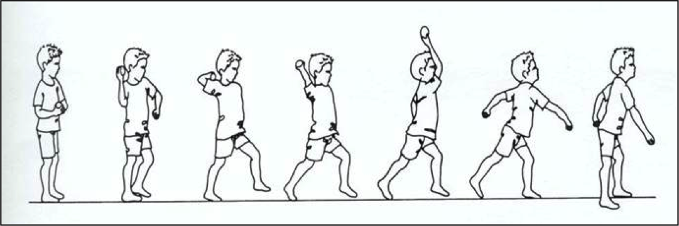
Stage 4¹
Movement is contralateral
Little or no rotation of the hips and spine during wind-up
Motion of trunk and arms resembles stages 1 and 3
Stride forward with contralateral leg provides a wide base of support and stability

Slide 11
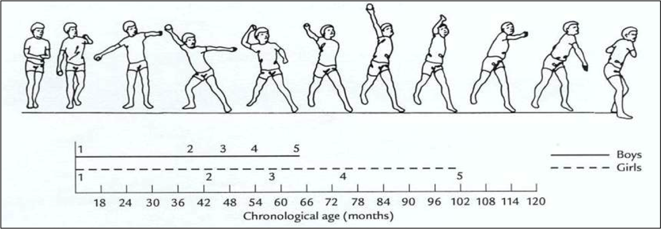
Mature Movement Pattern¹

Slide 12
Diagnostic Assessment
Activity
Have students throw and catch a football across the gym.
Use checklist to make note of observations.
Student | Target Arm Used | Contrilateral Stepping Phase | Contrilateral Body Movement | Reach Back with Throwing Arm | Rotation of Arm & Wrist | Follow Through with Throwing Arm | Hits Target
A | ✓ | ✓ | ✓ |  | ✓ | ✓ | ✓
B |  | ✓ | Awkward – needs repetition | Below ear level | More wrist snap needed | Early release | Inconsistnet
C | ✓ |  | ✓ |  | Arm-good Wrist-stiff |  | ✓
D |  |  | Inconsistent | Not far enough | Over turning | Over throwing | Rarely

Slide 13
Formative Assessment
Student A - Good - Target hitting very consistent | Student B - Good follow thr. -Contr. mvmt, inconsis. | Student C - Missing target often - Lacking confidence - More trunk rot. needed | Student D - Good - Impvd use of tgt arm | Student E - Not behind ear far enough - No arm rotn - Impvd target hitting
Student F | Student G | Student H | Student I | Student J

Slide 14
Summative Assessment
Learning Goal: B1.4 – Send & receive objects using different body
parts & equipment, adjusting for speed, while applying basic
principals of movement.³
THROWING | 4 | 3 | 2 | 1
Knowledge & Understanding Contrilateral movement shown Trunk rotation Uses target arm Appropriate flexion at hip Correct arm action with follow though Stability & control established | All elements shown consistently | Most elements shown consistently | Some elements shown consistently | Few elements shown consistently
Thinking Analyzes movement patterns Attempts to understand and make corrections given | Always | Usually | Sometimes | Rarely
Communication Uses correct vocabulary when communicating verbally | Always | Usually | Sometimes | Rarely
Application Uses developed throwing movement patterns in multiple situations including game play. | Consistently & Accurately | Consistently | Inconsistently | Struggles to

Slide 15
Things to Remember When Assessing & Evaluating in Physical Education…
The achievement chart on pages 38-39 are your primary resource.³
  Use the information in brackets to help you determine which achievement category you are evaluating.
Evaluation should not be completed based on the units you teach, it should be based on the expectations you are covering.
  There is no unit mark for volleyball however you may be covering several expectations when teaching a unit on volleyball.
  You must evaluate these expectations separately and not lump them altogether.
The qualifiers defining each levels within the achievement chart are vague.
  What is the difference between a Level 4 “with a high degree of effectiveness” and a Level 3 “with a considerable degree of effectiveness.”?
  This is where your professional judgment comes into play as now allowed by the government through the Growing Success document published last year.²
  It is not necessary or prudent to evaluate your students on a one time serving “test” in volleyball. Skill evaluation should be ongoing and students must be provided with several opportunities to demonstrate their skills for evaluation.
The mode (the highest, most frequent number) is used to assign term grades when evaluating in any subject not the mean (the average).²

Slide 16
References
1. Developing Fundamental Object-Control Skills. [PowerPoint slides]. Retrieved from
www.yorku.ca/bakerj/Object%20Control%20Skills%20web.ppt
(see this PPT for phases of catching, kicking, striking & punting)
2. Ontario. Ministry of Education. (2010). Growing success: Assessment,
evaluation & reporting in schools. Toronto: Author.
3. Ontario. Ministry of Education. (2010). The Ontario curriculum: Grades 1-8:
Health and Physical Education. Toronto: Author.

